Slide 1
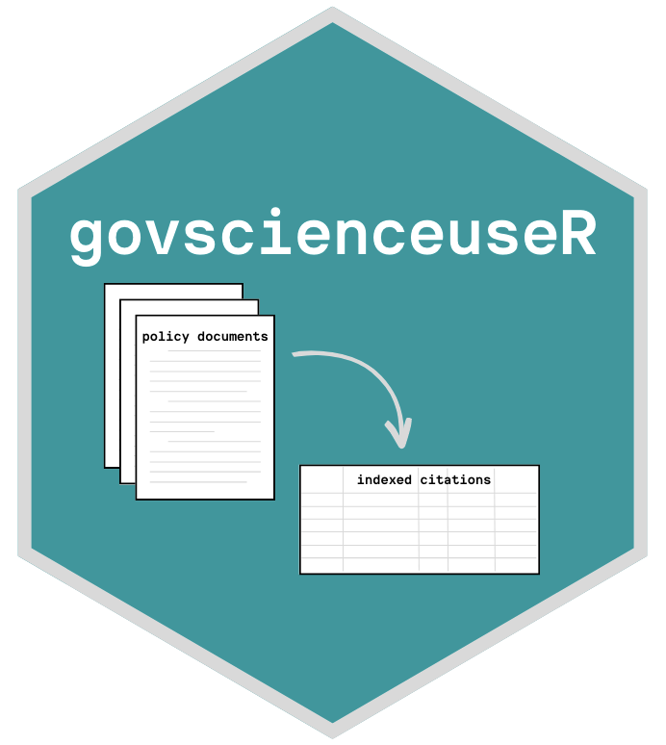
govscienceuseR: Tools for quantifying science in policy
Liza Wood
Tyler Scott
University of California, Davis

Slide 2
Policymakers should ‘listen to the science’
But how do we measure science in policy?
Goal: Align scientific supply & demand between researchers and policymakers (Sarewitz & Pielke 2007)
Interviews: Policymakers self-report neutrality regarding research use (Newman et al. 2016; Piczak et al. 2022)
Manual assessments of documents: Disconnect between supply & demand; reliance on governmental resources (Koontz 2022, Desmaris and Herd 2014)
govscienceuseR: variation in science-use across levels of policymaking; specialized journals (Wood & Scott 2022)
Challenges / caveats:
‘Science’ is not value-free (Sarewitz 2000)
Requires problem framing and persuasion of particular actors (Cairney et al. 2016)
Reliant on boundary spanners to bridge languages (Guston 2001)
Knowledge extends beyond ‘science’ (Vigar 2017)
toolkit for indexing & summarizing policy document references
Notes:
More automated data analysis typically requires uniformly formatted documents/citations and complete indices

Slide 3
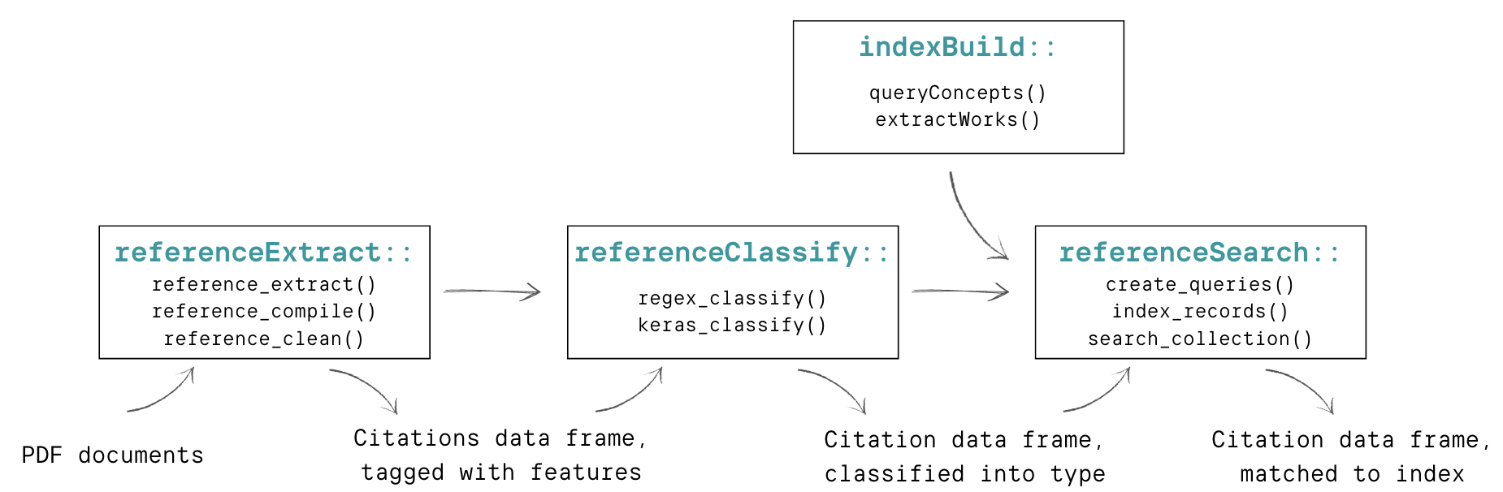

Slide 4
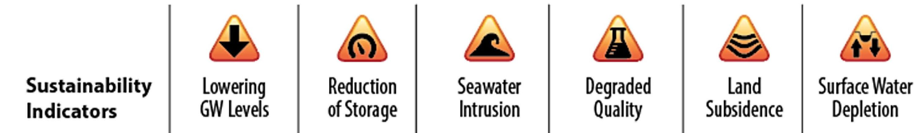
Example case: Groundwater Sustainability Plans (GSPs)
How is science used to inform the multiple
dimensions of groundwater sustainability?
Climate change
projections
Technology
Environmental
justice
Groundwater-reliant
industry
Drinking-water users
Power in industry
Infrastructure
(Bostic et al. 2020…)
Notes:
https://govt.westlaw.com/calregs/Document/IB64FB55A5B6E11EC9451000D3A7C4BC3?viewType=FullText&originationContext=documenttoc&transitionType=CategoryPageItem&contextData=(sc.Default)
When evaluating whether a Plan is likely to achieve the sustainability goal for the basin, the Department shall consider the following:
Whether the assumptions, criteria, findings, and objectives, including the sustainability goal, undesirable results, minimum thresholds, measurable objectives, and interim milestones are reasonable and supported by the best available information and best available science.

Slide 5
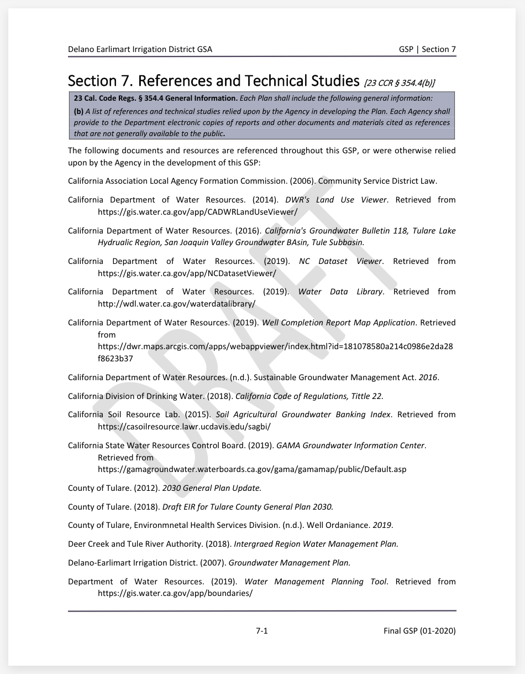
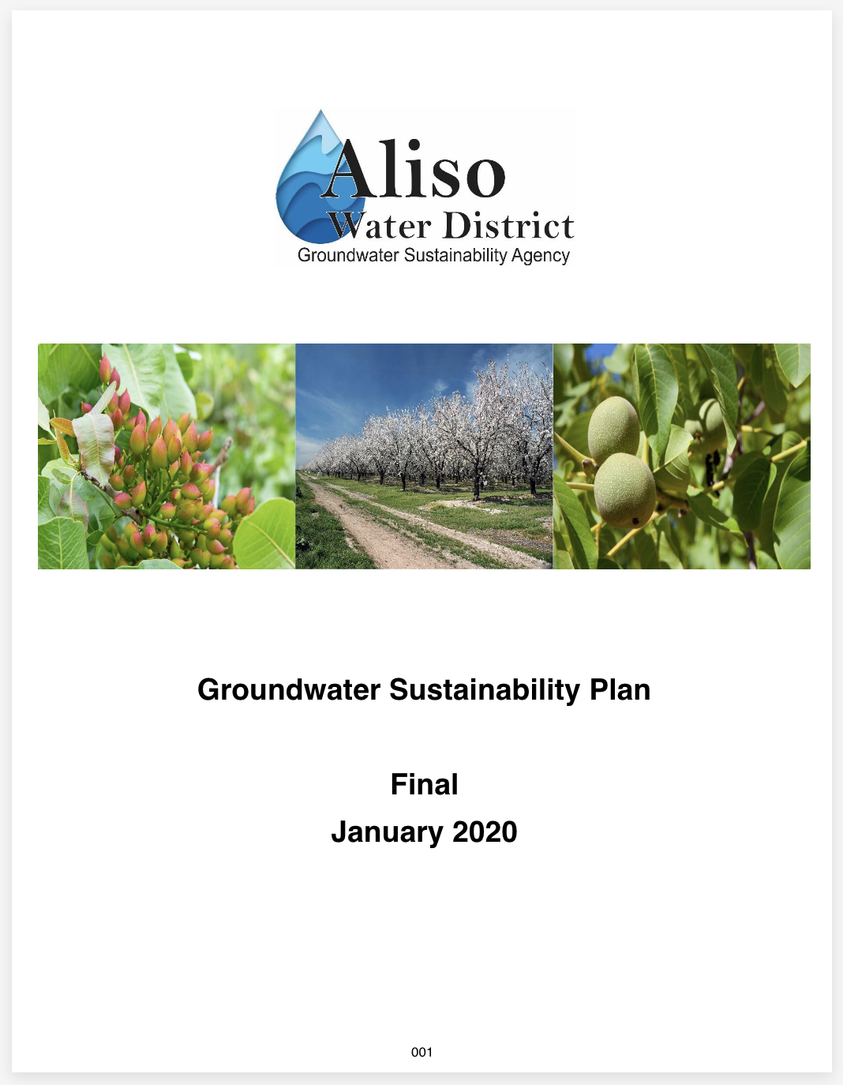
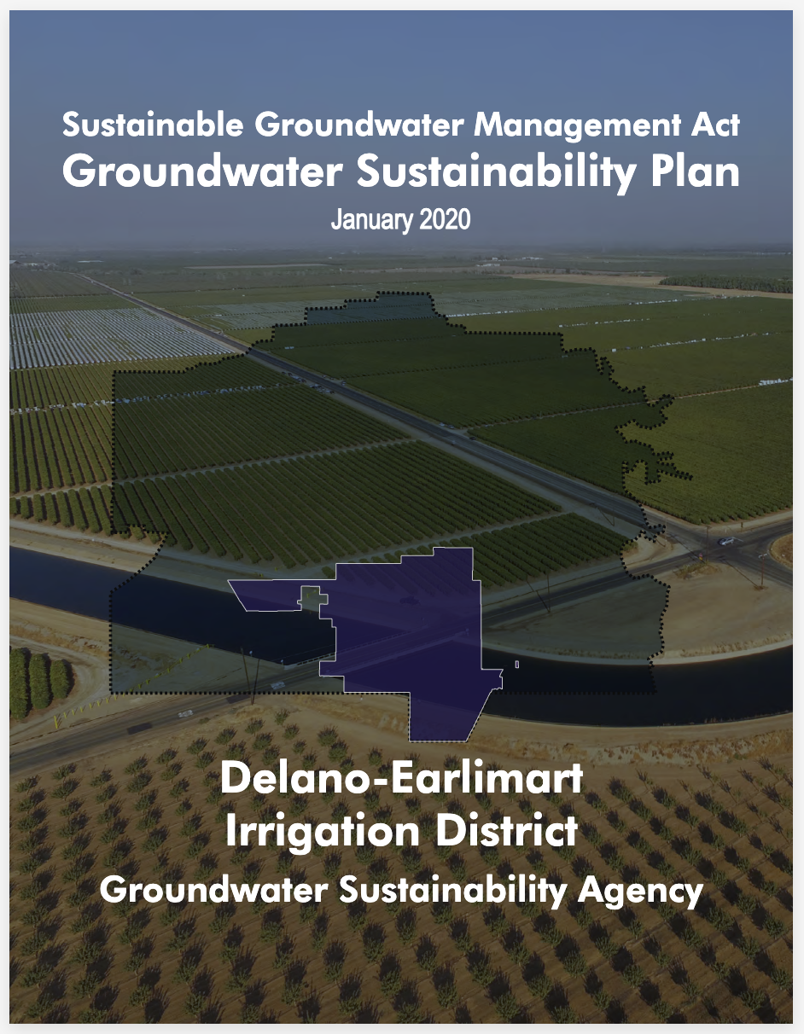
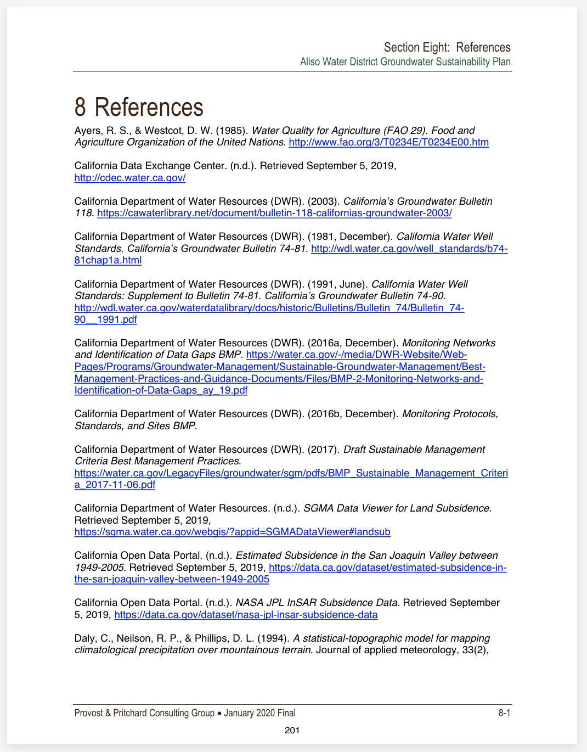
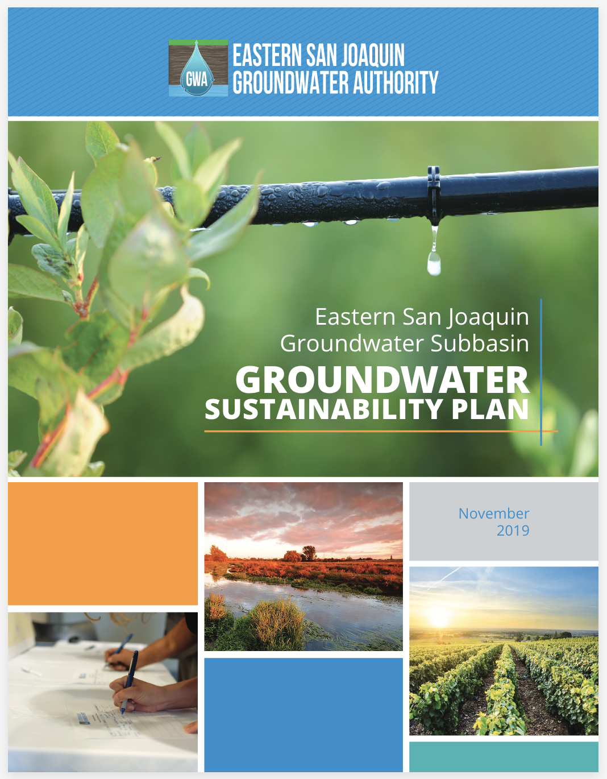
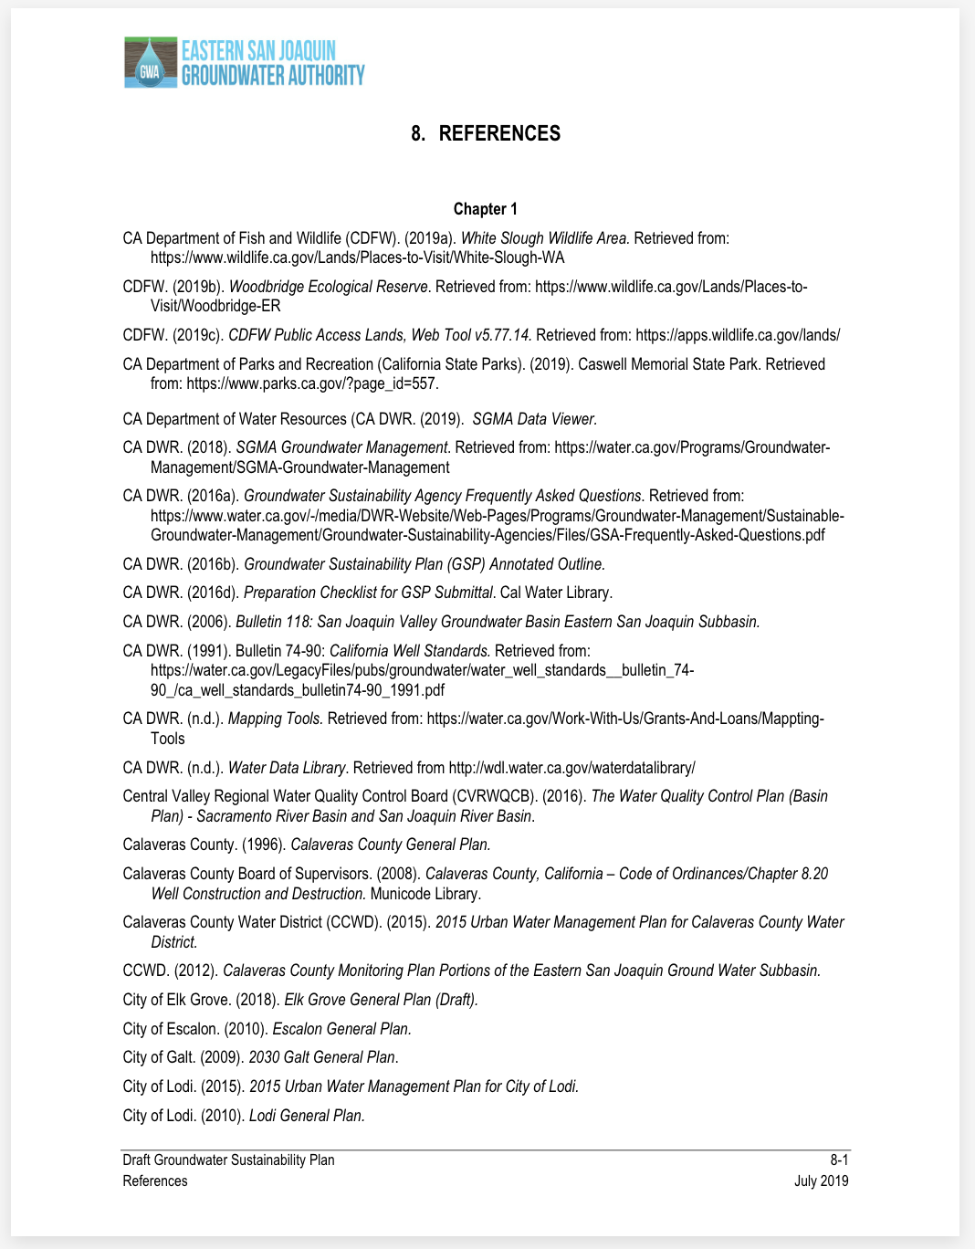
Example case: Groundwater Sustainability Plans (GSPs)
…
115 documents
160K+ pages

Slide 6
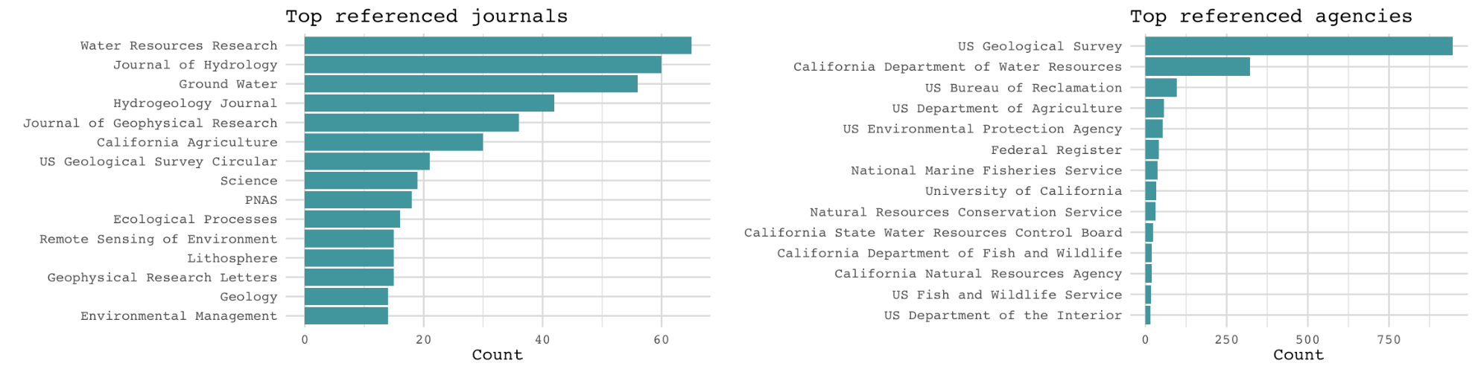
114 documents
~160K pages
~14K probable
citations
1,856 journal refs
3,675 agency refs

Slide 7
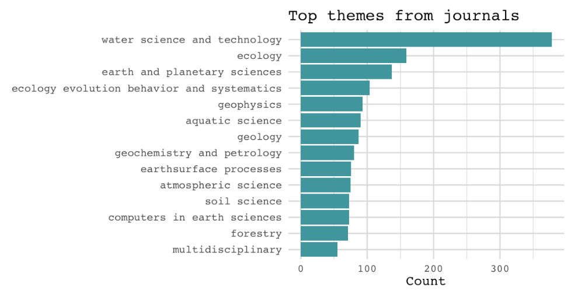
197 themes/keyworks -> 3,982 concepts -> XM works
Federal register -> X works
114 documents
~160K pages
~14K probable
citations
1,856 journal refs
3,675 agency refs

Slide 8
192 themes/keyworks -> 3,982 concepts -> XM works
Federal register -> X works
114 documents
~160K pages
~14K probable
citations
1,856 journal refs
3,675 agency refs
X indexed refs
Index summary
Text summary?

Slide 9
Preliminary results
Next steps
How is science used to inform the multiple dimensions of groundwater sustainability?
Challenges
Indexing government documents (currently relying on specialized builds, interested in fed reg?)
Improving matching
Default openAlex search index?
Improvements:
Access text of documents and build in text analysis tools
Collaborations:
Add document metadata to look for patterns based on authoring agency (e.g. GSA composition, #DAC, overdraft level, core challenge)
Other document ideas?
…

Slide 10
govscienceuser.github.io/
Liza Wood
Tyler Scott
University of California, Davis

